Slide 1
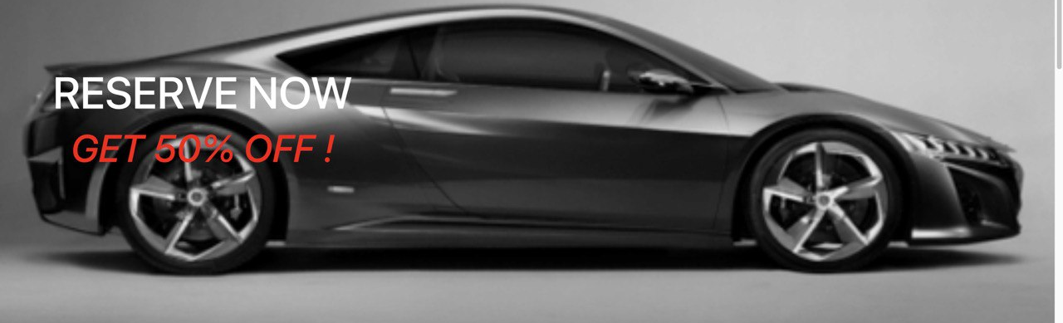
Car Rental System
Customize to suit your business

Slide 2

Introduction
.
Welcome to Ecar Rental, your destination for eco-friendly transportation. With our range of electric vehicles, you can enjoy a clean and quiet driving experience while reducing your carbon footprint. Book your electric car today and join the movement towards sustainable travel.

Slide 3
Car Rental System Overview
Record data
Give updates any time
Integrated system
Cost effective online system
User friendly

Slide 4
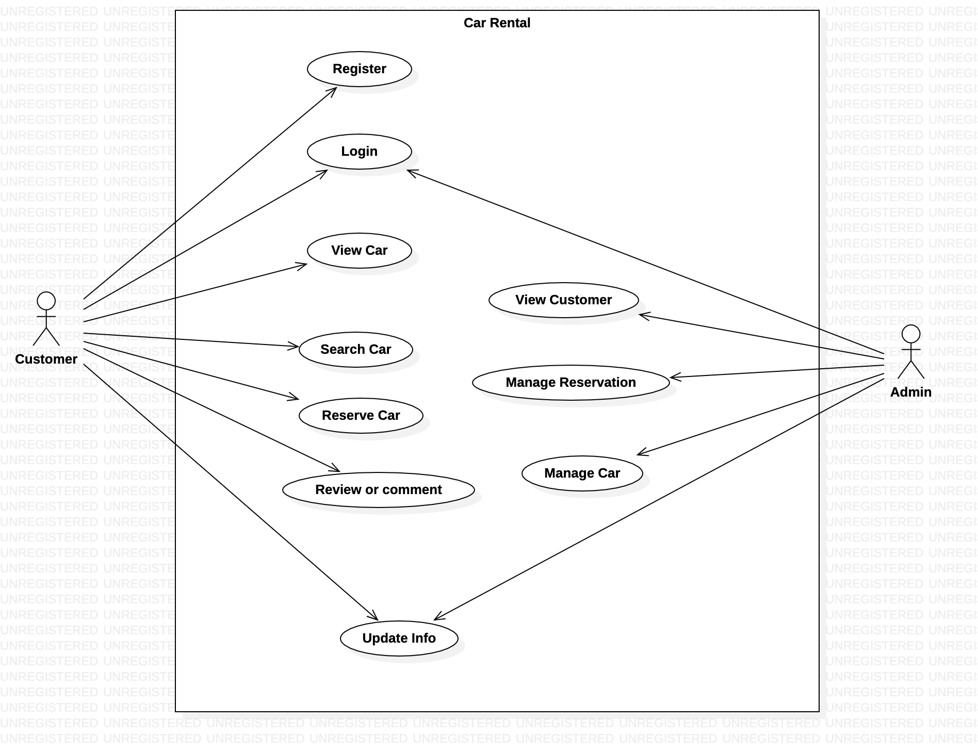
Use case diagram

Slide 5
Acceptance Criteria:
Start and end dates required for car rental.
Personal information must be provided.
Display error message for missing information.
Prevent renting unavailable cars.
Search Car:
Search by car ID, make, or model.
Return "No match found" if car doesn't exist.
Login:
Username and password required for login.
Reset password option available.

Slide 6
Main Scenario:
1. Rent A Car:
- Select car.
- Fill required information.
- Submit and receive rental confirmation.
2. Search Car:
- Enter car information.
- Click search button.
- Receive availability status.
3. Login:
- Enter username and password.
- Login to personal page.
- Choose desired action.

Slide 7
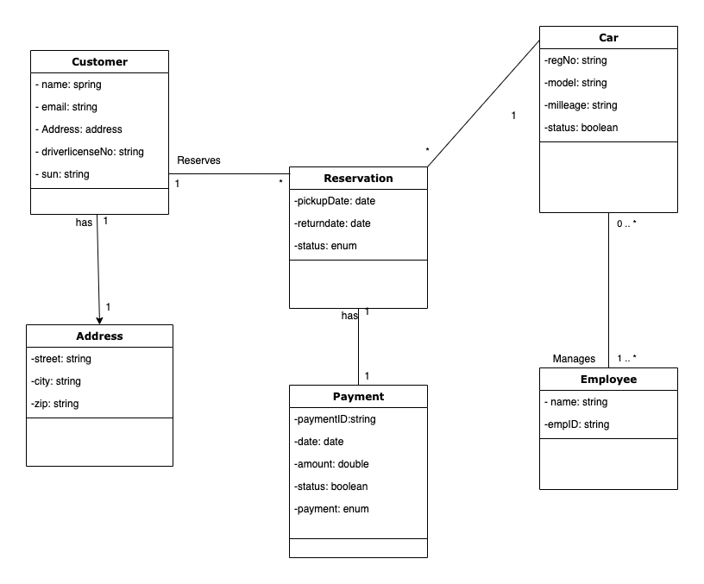
Class diagram

Slide 8
The End!
Thank you

